Slide 1
MATH221
Mathematics for Computer Science
Unit 7
Mathematical Induction

Slide 2
OBJECTIVES
Understand and apply Mathematical Induction.
Understand and apply the Generalized Principle of Mathematical Induction.
Understand the Sigma Notation and Recursive Definitions.
Understand and apply the Principle of Strong Mathematical Induction.

Slide 3
The Basic Principle of Mathematical Induction: Example
Prove n³ > 2n - 2 for all natural numbers, n.
Can we use the exhaustive method to prove this statement ? No.
Let CLAIM(n) be “n³ > 2n – 2”.
For n = 1: CLAIM(1) is 1³ > 2 × 1 – 2
LHS = 1; RHS = 0 ⇒ LHS > RHS.
For n = 2: CLAIM(2) is 2³ > 2 × 2 – 2
LHS = 8; RHS = 2 ⇒ LHS > RHS.
For n = 3: CLAIM(3) is …
The process above will NEVER prove the CLAIM for ALL natural number n.

Slide 4
The Principle of Mathematical Induction
For all natural numbers n, let CLAIM(n) be a statement. If
1. CLAIM(1) is true, and
2. the truth of CLAIM(k) implies the truth of
CLAIM(k + 1) for all natural numbers k,
then CLAIM(n) is true for all natural numbers n.

Slide 5
The Principle of Mathematical Induction: Proof
Let T = {t ∈ ℕ: CLAIM(t) is false}.
If we can show that T is empty, then CLAIM(n) is true for n ∈ ℕ.
Note that T is a subset of ℕ. Also, we know the following:
1. CLAIM(1) is true, and
2. the truth of CLAIM(k) implies the truth of
CLAIM(k + 1) for all natural numbers k.
Assume T is not empty.
Then T has a least element.
[A result of well-ordering property on ℕ]

Slide 6
The Principle of Mathematical Induction: Proof
Let this least element be t₀, so
CLAIM(t₀) is false. (*)
By statement 1 above t₀ ≠ 1, so t₀ - 1 is a natural number.
Also, t₀ – 1 is not in T. Therefore, CLAIM(t₀ – 1) is true. However, by statement 2 above,
CLAIM(t₀ – 1) true implies that
CLAIM(t₀ – 1 + 1) = CLAIM(t₀) is true.
This is a contradiction with statement (*).
So, our assumption that T is not empty must be false.
Hence, T must be empty.
Therefore, CLAIM(n) is true for all n ∈ ℕ.

Slide 7




The Principle of Mathematical Induction: Example
Prove 1 + 2 + … + n , for n ∈ ℕ.
Let CLAIM(n) be “1 + 2 + … + n ”.
Does the claim satisfy the conditions of the Principle of Mathematical Induction?
1. Is CLAIM(1) true?
CLAIM(1) is . LHS = 1; RHS = .
Therefore, LHS = RHS and so CLAIM(1) is true.
$$=\frac{n\left(n+1\right)}{2}$$
$$=\frac{n\left(n+1\right)}{2}$$
$$1=\frac{1\left(1+1\right)}{2}$$
$$\frac{2}{2}=1$$

Slide 8


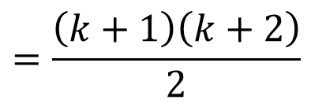
The Principle of Mathematical Induction: Example
2. We must show that for k ≥ 1,
CLAIM(k) is true ⇒ CLAIM(k + 1) is true.
Assume CLAIM(k) is true, that is,
1 + 2 + … + k (*)
Prove CLAIM(k + 1) is true, that is,
1 + 2 + … + k + (k + 1)
$$=\frac{k\left(k+1\right)}{2}$$
$$=\frac{\left(k+1\right)\left(k+1+1\right)}{2}$$
$$=\frac{\left(k+1\right)\left(k+2\right)}{2}$$

Slide 9
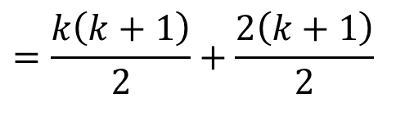
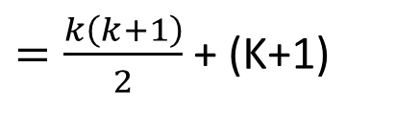
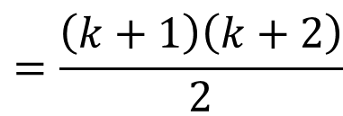
The Principle of Mathematical Induction: Example
LHS = 1 + 2 + … + k + (k + 1)
Therefore, LHS = RHS.
Therefore, CLAIM(k + 1) is true.
So, CLAIM(n) satisfies both the conditions of the Principle of Mathematical Induction.
Therefore, by induction, CLAIM(n) is true for all n ∈ ℕ.
$=\frac{k\left(k+1\right)}{2}$ + (K+1)
(Using *)
$$=\frac{k\left(k+1\right)}{2}+\frac{2\left(k+1\right)}{2}$$
$$=\frac{\left(k+1\right)\left(k+2\right)}{2}$$

Slide 10
The Principle of Mathematical Induction: Summary
To establish an infinite family of claims, (CLAIM(1), CLAIM(2), CLAIM(3), …) using the Principle of Mathematical Induction, it is sufficient to carry out the following two steps:
Step 1: Prove that the first claim, CLAIM(1) is true.
Step 2: Give a general proof that if CLAIM(k) is true then CLAIM(k + 1) is also true, whatever the value of k ∈ ℕ.
The first step is called the basis step and the second step is called the inductive step.

Slide 11
Aside: Note on Formula for Algebraic Expansion
(x + y)² = x² + y² + 2xy
(x + y)³ = x³ + y³ + 3xy(x + y)

Slide 12
The Principle of Mathematical Induction: Example
Prove n³ > 2n - 2 for all natural numbers, n.
Let CLAIM(n) be “n³ > 2n – 2”.
Step 1: CLAIM(1) is 1³ > 2 × 1 – 2.
LHS = 1; RHS = 0.
Therefore, LHS > RHS and so CLAIM(1) is true.
Step 2: Assume CLAIM(k) is true for some k ∈ ℕ, that is,
k³ > 2k – 2. (*)
Prove CLAIM(k + 1) is true, that is, prove that
(k + 1)³ > 2(k + 1) – 2.
that is, to prove that (k + 1)³ > 2k.

Slide 13
The Principle of Mathematical Induction: Example
LHS = (k + 1)³
= k³ + 3k² + 3k + 1 (refer to the Appendix for the formula)
> (2k – 2) + 3k² + 3k + 1 (using *)
≥ 2k – 2 + 3 + 3 + 1 (since k ≥ 1)
= 2k + 5
> 2k
= RHS
Therefore, (k + 1)³ > 2(k + 1) – 2 and so CLAIM(k + 1) is true.
Therefore, by induction, CLAIM(n) is true for all n ∈ ℕ.

Slide 14
The Generalized Principle of Induction: Example
Prove that 2^{n} > 2n + 1 by induction.
Let CLAIM(n) be 2^{n} > 2n + 1 for n ∈ ℕ.
Step 1: CLAIM(1) is 2¹ > 2(1) + 1.
LHS = 2; RHS = 3.
LHS < RHS!!!
The fact is that 2^{n} > 2n + 1 is true for n ≥ 3, n ∈ ℕ.
Sometimes we would like to prove a CLAIM that only works for values greater than 4, say.
The Principle of Mathematical Induction can be generalized to “accommodate” this type of problem.

Slide 15
The Generalized Principle of Induction
Suppose that q is some integer. For all integers n ≥ q, let CLAIM(n) be a statement. If
1. CLAIM(q) is true, and
2. the truth of CLAIM(k) implies the truth of
CLAIM(k + 1) for all integers k ≥ q,
then CLAIM(n) is true for all integers n ≥ q.
Note that the proof is almost identical to the proof to that for the Principle of Mathematical Induction.

Slide 16
The Generalized Principle of Induction: Note
This generalized principle is applied in the same way as before, except that at
Step 1: we prove CLAIM(q) instead of CLAIM(1), and
Step 2: we may need the information that k ≥ q instead of k ≥ 1.
Note that q can be any integer: positive, negative or zero.

Slide 17
Exercise:
Prove that 2^{n} > 2n + 1 for n ≥ 3, n ∈ ℕ.
Let CLAIM(n) be 2^{n} > 2n + 1.
Step 1: CLAIM(3) is 2³ > 2(3) + 1.
LHS = 8; RHS = 7.
Therefore, LHS > RHS and so CLAIM(3) is true.
Step 2: Assume CLAIM(k) is true for some k ≥ 3, k ∈ ℕ, that is,
2^{k} > 2k + 1. (*)
Prove CLAIM(k + 1) is true, that is, prove that
2^{k + 1} > 2(k + 1) + 1 = 2k + 3.

Slide 18
Exercise:
LHS = 2^{k + 1}
= 2^{k}(2)
> (2k + 1)(2) (using *)
= 4k + 2
= 2k + 2k + 2
> 2k + 1 + 2 (since k ≥ 3, 2k > 1)
= 2k + 3
= RHS
Therefore, 2^{k + 1} > 2k + 3 and so CLAIM(k + 1) is true.
Therefore, by induction, CLAIM(n) is true for all natural numbers n ≥ 3.

Slide 19
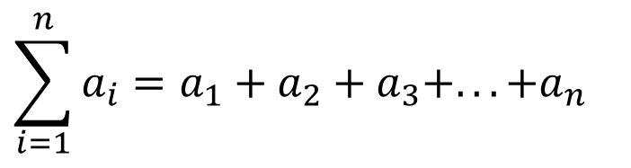
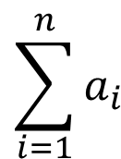
Sigma Notation
$$\sum_{i=1}^{n}{a_{i}}$$
The notation denotes the sum of the numbers
a₁, a₂, a₃, …, a_{n}; that is
$$\sum_{i=1}^{n}{a_{i}}=a_{1}+a_{2}+a_{3}+...+a_{n}$$

Slide 20
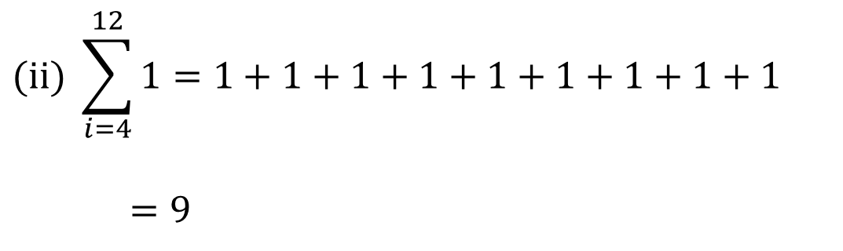
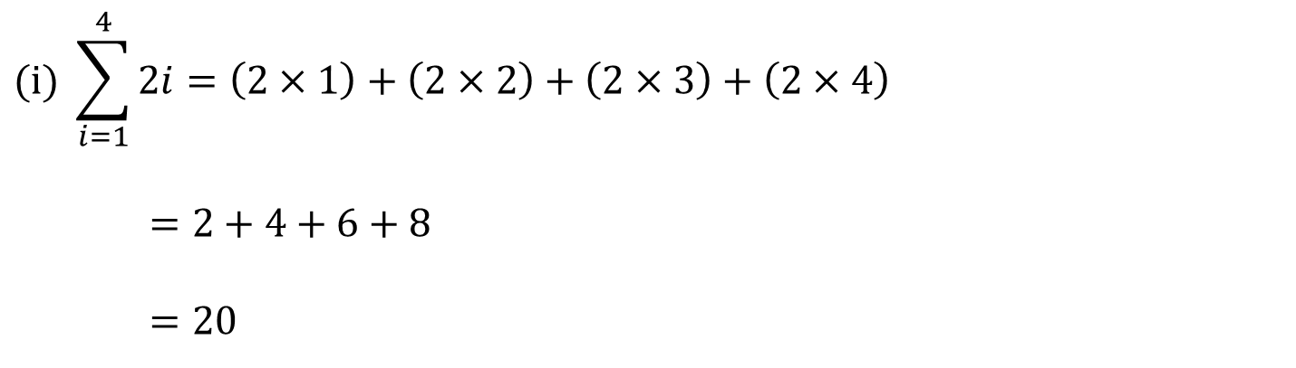
Sigma Notation: Examples
$$(i) \sum_{i=1}^{4}{2i}=\left(2×1\right)+\left(2×2\right)+\left(2×3\right)+\left(2×4\right)$$
    $$=2+4+6+8$$
    $$=20$$
$$(\text{ii}) \sum_{i=4}^{12}{1}=1+1+1+1+1+1+1+1+1$$
    $$=9$$

Slide 21
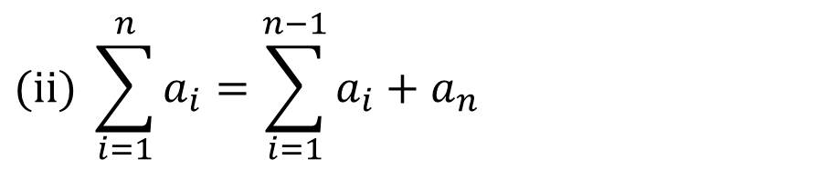
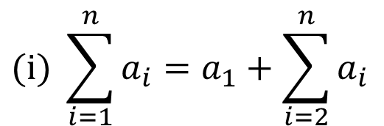
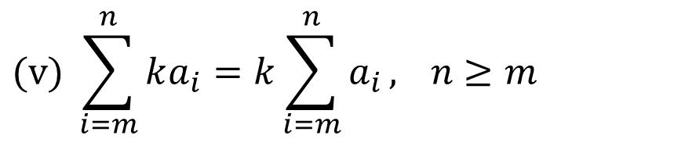
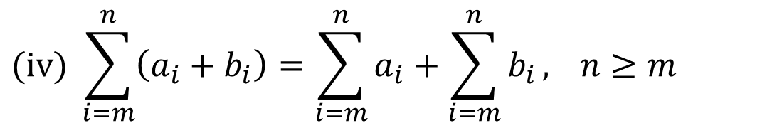
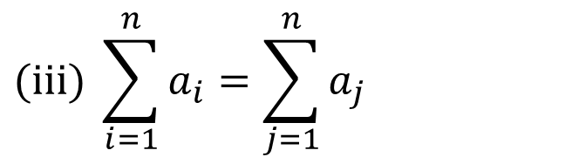
Sigma Notation: Equalities
$$(i) \sum_{i=1}^{n}{a_{i}}=a_{1}+\sum_{i=2}^{n}{a_{i}}$$
$$(\text{ii}) \sum_{i=1}^{n}{a_{i}}=\sum_{i=1}^{n−1}{a_{i}}+a_{n}$$
$$(\text{iii}) \sum_{i=1}^{n}{a_{i}}=\sum_{j=1}^{n}{a_{j}}$$
$$(\text{iv}) \sum_{i=m}^{n}{\left(a_{i}+b_{i}\right)}=\sum_{i=m}^{n}{a_{i}}+\sum_{i=m}^{n}{b_{i}}, n≥m$$
$$(v) \sum_{i=m}^{n}{ka_{i}}=k\sum_{i=m}^{n}{a_{i}}, n≥m$$

Slide 22
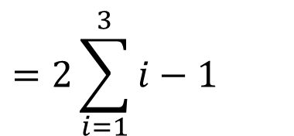

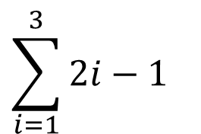
Discussion:
$$\sum_{i=1}^{3}{2i}−1=9$$
True or False?
$$\sum_{i=1}^{3}{2i}−1$$
$$=2\sum_{i=1}^{3}{i}−1$$
= 2(1 + 2 + 3) - 1
= 11 (≠ 9)

Slide 23
Recursive Definitions
Sequences of numbers are defined recursively if each new number depends on previous values.

Slide 24
Recursive Definitions: Example
Let u₁, u₂, …, u_{n}, … be real numbers defined by
u₁ = 2 and u₂= 4
and
u_{n} = 5u_{n - 1} - 6u_{n - 2}, for n ≥ 3.
Find u₄:
u₃ = 5u₂ - 6u₁ (n = 3)
= 5 × 4 – 6 × 2
= 8
u₄ = 5u₃ - 6u₂ (n = 4)
= 5 × 8 – 6 × 4
= 16.

Slide 25
Recursive Definitions: Note
The numbers can often be defined directly.
For example, u_{n} = 2^{n} in the previous example.

Slide 26
The Principle of Strong Mathematical Induction
For integer n, let CLAIM(n) be a statement and let a and b be fixed integers with a ≤ b. If
1. CLAIM(a), …, CLAIM(b) are true, and
2. the truth of CLAIM(i) for all integers i with
a ≤ i < k implies the truth of CLAIM(k) for all integers k > b,
then CLAIM(n) is true for all integers n ≥ a.

Slide 27
Aside: Notes on Divisibility
The expression “a | b” reads “a divides b”, or, “a is a factor of b”, or, “a is a divisor of b”.
It means “b is divisible by a”, or, “b is a multiple of a”, or more formally, there is an l ∈ ℤ so that b = al.
Examples.
(i) 6 | 12
(ii) 7 | (a² – 2) ⇔ there is l ∈ ℤ, a² – 2 = 7l.
(iii) 6 | 25 reads “6 does not divide 25”.
When a proof involves showing a | b, you need to express b as a multiple of a, that is, find l ∈ ℤ so that b = al.
/

Slide 28
The Principle of Strong Mathematical Induction: Example
Suppose that b₁, b₂, b₃, … is a sequence defined as follows:
b₁ = 4, b₂ = 12,
b_{k} = b_{k - 2} + b_{k - 1} for all integers k ≥ 3.
Prove that b_{n} is divisible by 4 for all integers n ≥ 1.
Let CLAIM(n) be b_{n} is divisible by 4.
Step 1: CLAIM(1) is b₁ = 4 is divisible by 4.
CLAIM(2) is b₂ =12 is divisible by 4.
Since 4 and 12 are divisible by 4, CLAIM(1) and CLAIM(2) are true.
Notes:
Given any real number x, the floor of x, or greatest integer in x, denoted ⎣x⎦, is the largest integer that is less than or equal to x.

Slide 29
The Principle of Strong Mathematical Induction: Example
Step 2: Let k > 2 be an integer, and suppose Claim(i) is true for all integers i with 1 ≤ i < k. That is, b_{i} is divisible by 4 for all integers i with 1 ≤ i < k. That is, (*)
  Prove that CLAIM(k) is true, that is, prove that b_{k} is divisible by 4.
Now, b_{k} = b_{k - 2} + b_{k - 1}.
  Since k > 2, 1 ≤ k – 2 < k and 1 < k – 1 < k , and so, by inductive hypothesis, both b_{k - 2} and b_{k – 1} are divisible by 4.
    From definition of divisibility, this implies that b_{k - 2} = 4x and b_{k – 1} = 4y, where x, y ∈ Z.
    Thus, b_{k} = b_{k - 2} + b_{k – 1} = 4(x + y), where x + y ∈ Z.
    Hence, b_{k} is divisible by 4.
  Therefore, CLAIM(k) is true.
  Therefore, by induction, CLAIM(n) is true for all integers n ≥ 1.

Slide 30
End of Unit 7

